Slide 1
LONGROAD GLASS & ALUMINIUM INTERIOR
Contact details
Telephone number – 057 353 3080
Whatsapp number – 072 895 7887
Email addres – longroadaluminium@gmail.com
397 Longroad , Welkom

Slide 2
WE DO THE FOLLOWING
Title
Wall paneling
Framing
Canvas
Glass art
Vinyl designs
Wall art

Slide 3
WALL PANELING RANGE
Wall paneling can come in different styles, patterns, and finishes, allowing for a wide range of design possibilities.
It can be installed vertically, horizontally, or in a combination of both orientations, depending on the desired look and feel.
We have the following different color range that you can choose from. Grey, Black, Maple, Kiaat, Birch, Grey oak, Cedar and also Bamboo.
There is also 2 different thickness of the wall panels that will include the 40mm and the 28mm Slat. The height of these wall panels comes in 2.4m and 2.7m

Slide 4
WALL PANELING RANGE

Slide 5
WALL PANELING RANGE

Slide 6
FRAMING OF PICTURES, MIRRORS ETC
Picture framing requires attention to detail, a keen eye for design, and the ability to bring out the best features of the picture being framed. It is both a practical and artistic process that adds value and beauty to the artwork or photograph it encloses.
We can do box framing of clothes or an object like a guitar or medals. We do the mounting around the picture or object and we can put clear glass or non reflective glass. If we frame the mirrors we can go up to a size of 1.8m by 2.4m. Canvas we can also frame of any size. We can frame anything that your heart desires.

Slide 7
FRAMING

Slide 8
FRAMING

Slide 9
CANVAS
Canvas pictures are a popular type of art and photography display.
The canvas itself adds a textured and artistic feel to the picture, giving it a more sophisticated and gallery-like appearance.
They can feature any type of image, such as landscapes, cityscapes, animals, abstract designs, or even personal photographs.
Overall, canvas pictures are aesthetically pleasing, durable, and visually striking, making them a popular choice for displaying artwork and photographs.
We can do any kind of canvas to the size that you want. We can do the canvas and if you prefer to frame it we can also include the framing.

Slide 10
CANVAS

Slide 11
CANVAS

Slide 12
CANVAS

Slide 13
GLASS ART
Glass stickers, also known as window films or window decals, are transparent or semi-transparent adhesive films that can be applied to glass surfaces.
These stickers are designed for both decorative and functional purposes.
Glass stickers are generally easy to install and remove, making them a convenient choice for temporary or seasonal decorations.
They are versatile and can be used in homes, offices, retail stores, restaurants, and other commercial spaces.
GLA - 01

Slide 14
GLASS ART
GLA- 02
GLA - 03

Slide 15
GLASS ART
GLA - 04

Slide 16
GLASS ART
GLA - 05
GLA - 06

Slide 17
VINYL DESIGNS
Vinyl designs are highly durable and weather-resistant, making them suitable for both indoor and outdoor use. The vinyl material can withstand various environmental factors such as UV rays, humidity, and temperature changes, ensuring that the designs remain intact over time.
Furthermore, if the design needs to be removed or changed, the vinyl can be peeled off without leaving any residue or damaging the surface.
With advancements in technology, vinyl designs can now be produced in vibrant colors, gradients, and even textured finishes.
VD - 01

Slide 18
VINYL DESIGNS
VD - 02
VD - 03

Slide 19
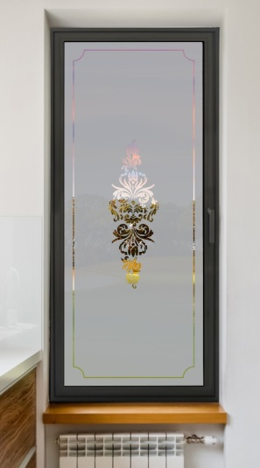
VINYL DESIGNS
VD - 04
VD - 05
VD - 06

Slide 20
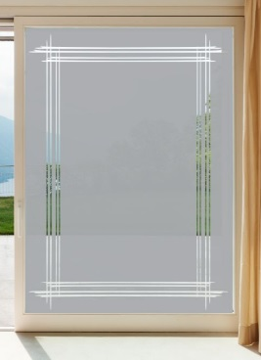
VINYL DESIGNS
VD - 07
VD - 08
VD - 09

Slide 21
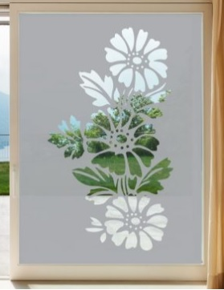
VINYL DESIGNS
VD - 10
VD - 11
VD - 12

Slide 22
VINYL DESIGNS
VD - 13
VD - 14

Slide 23
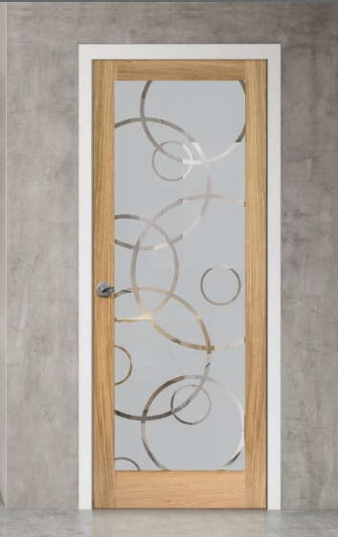
VINYL DESIGNS
VD - 15
VD - 16
VD - 17

Slide 24
VINYL DESIGNS
VD - 18
VD - 19

Slide 25
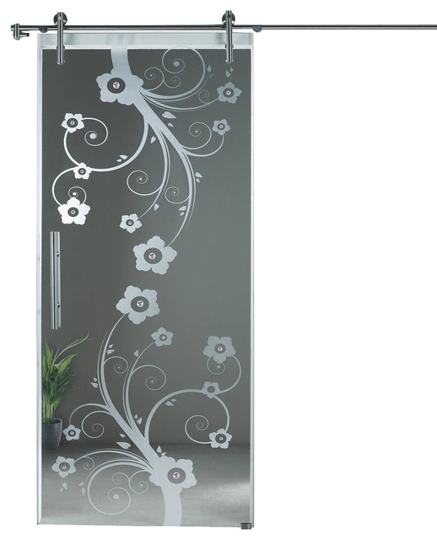
VINYL DESIGNS
VD - 20
VD - 21
VD - 22

Slide 26
WALL ART
Wall art not only serves as a decorative element but also adds depth, color, and character to a space.
Overall, wall art serves as a medium for self-expression, conveying emotions, creating visual interest, and reflecting personal style within a space. It allows individuals to enhance and customize their surroundings to create a unique and aesthetically pleasing environment.
It can range from traditional paintings and drawings to modern and contemporary pieces, including photographs, prints, posters, murals, tapestries, sculptures, and more.

Slide 27
WALL ART

Slide 28
WALL ART

Slide 29
WALL ART

Slide 30
WALL ART

Slide 31
WALL ART

